Slide 1

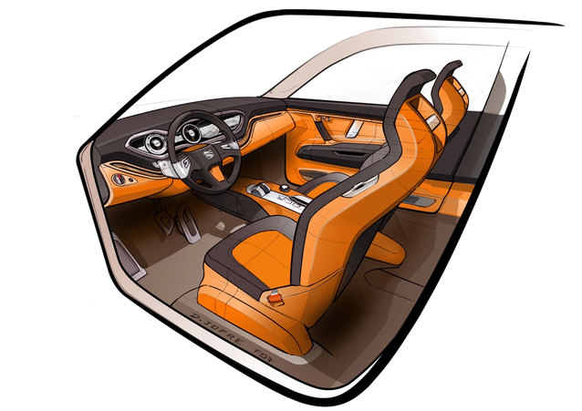
CSS
(Cascading Style Sheets)
1.Style: Sets the look and feel. 2.Colors & Fonts: Customizes
text and background.
3.Layout: Controls position and
size.
4.Selectors: Targets specific
HTML elements.

Slide 2

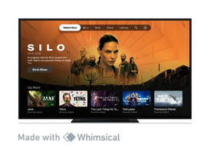




Importance of CSS
Premium Website
Premium Brand
Premium Customer
High Salary Developer

Slide 3
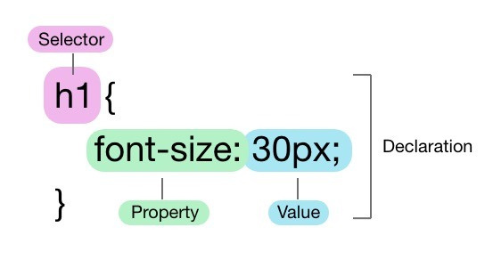
1. Basic Syntax
• •
•
Selector: The HTML element that you want to style. Property: The attribute you want to change (like font, color, etc.).
Value: The specific style you want to apply to the property (like
red, bold, etc.).

Slide 4
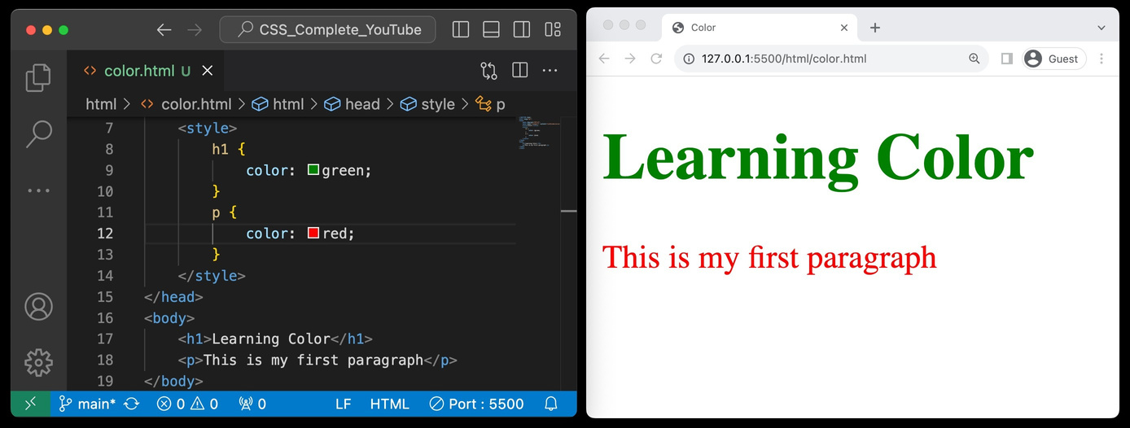
2. Color Property
• •
Definition: The CSS color property defines the text color or foreground color in an HTML element. Enhancement: Use it to emphasize sections and
elevate webpage aesthetics.

Slide 5
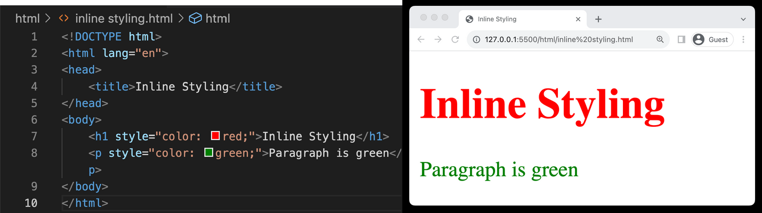
3.
Including Styles
(Inline Styling)
• •
•
•
Direct Application: Apply styles directly to HTMLelements using the style attribute. One-off Changes: Ideal for single, unique style alterations. Can Be Cluttered: May lead to clutteredHTML if used extensively.
Limited Reusability: Reduces the reusabilityof CSS rules in larger
projects.

Slide 6
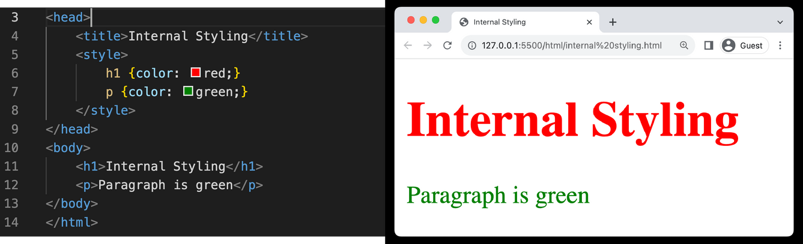
3.
Including Styles
(Internal Styling)
• •
•
Embedded CSS: Styles are placed within <style> tags in the HTML head section. Cleaner than Inline: More organizedcompared to inline styles. Reusable Styles: Allows for some reuseof styles across the page.

Slide 7
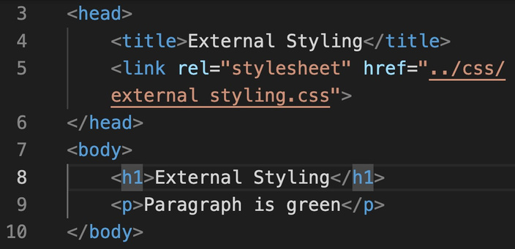
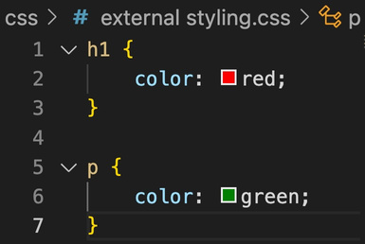
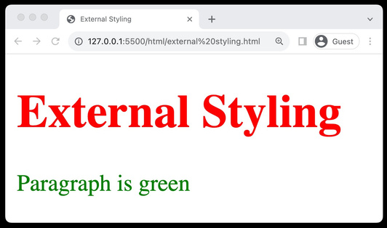
3.
Including Styles
(External Styling)
• • • •
Separate CSS File: Stores styles in a separate .cssfile, linked to HTML. Reusable: Enables style reuseacross multiple webpages. Link in HTML: Use the <link> tag within the <head> section to link the CSS. Relative or Absolute Path: The hrefattribute can contain a relative or
absolute path to the CSS file.

Slide 8
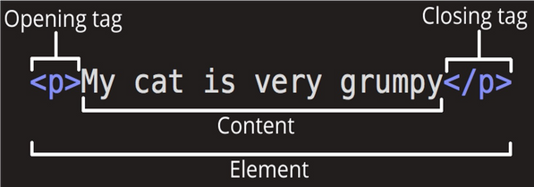
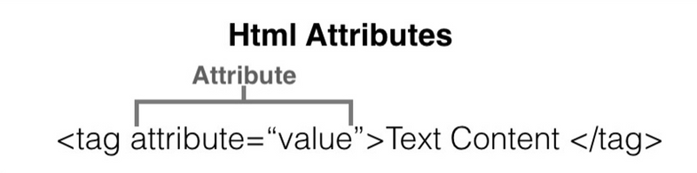
4.
HTML Refresher
(Tags & Attributes)
1.Elementsthat are used to
1.Provides additional information
create a website are called HTML Tags.
about elements
2.Use name=valueformat
2.Tags can contain content or
other HTML tags.
3.Define elements like text,
images, links

Slide 9
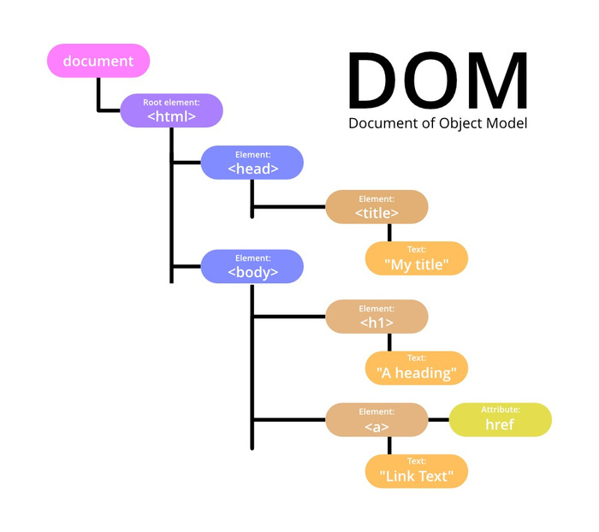
4.
HTML Refresher
(DOM)
1.Structure Understanding: Helps in understanding the hierarchical structure of a webpage, crucial for applying targeted CSS styles. 2.Dynamic Styling: Enables learning about
dynamic styling, allowing for real-time changes
and interactivity through CSS.

Slide 10
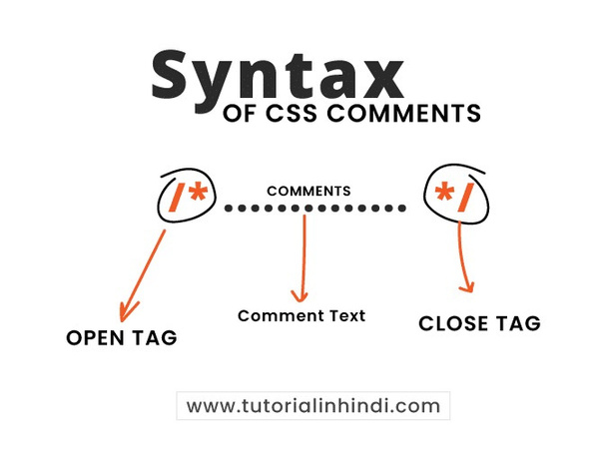
5 Comments
1.Used to add notesin HTML or
CSS code
2.Not displayedon the web page 3.Syntax: <!--Comment here --> 4.Helpful for code organization 5.Can be multi-line orsingle-line

Slide 11
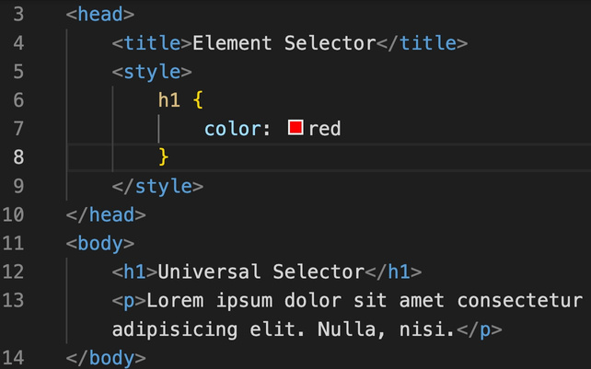
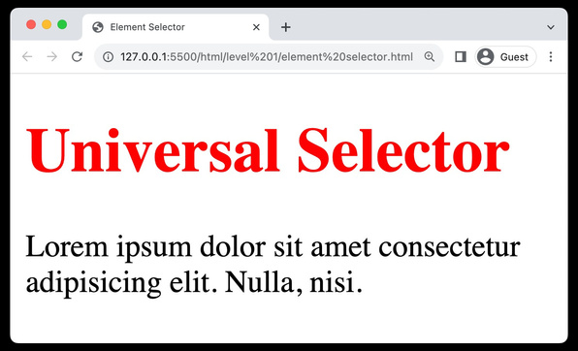
8.
Selectors
(Element selector)
• • • •
Targets Elements: Selects HTML elements based on their tag name. Syntax: Simply use the element's name Uniform Styling: Helps in applying consistent styles to all instances. Ease of Use: Straightforward and easyto implement for basic styling.

Slide 12
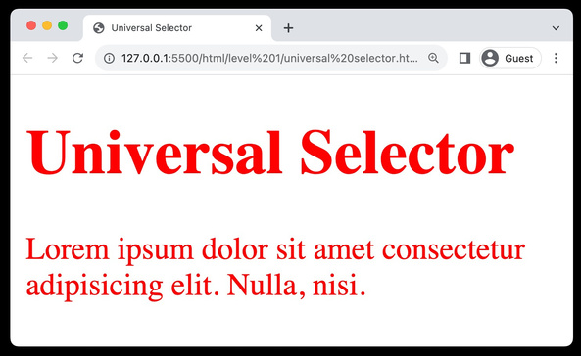
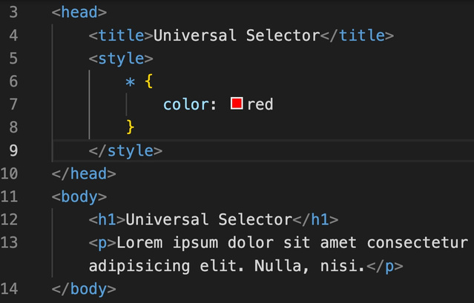
8.
Selectors
(Universal selector)
• • •
•
•
Matches All: Targets and styles all elementson a webpage. Syntax: Utilized as an asterisk (*). Resets Styles: Commonly used to reset marginsand paddings globally.
Broad Styling: Useful for setting universal attributes like font or color.
Usage Caution: Can cause style conflictsdue to its wide-reaching effects.

Slide 13
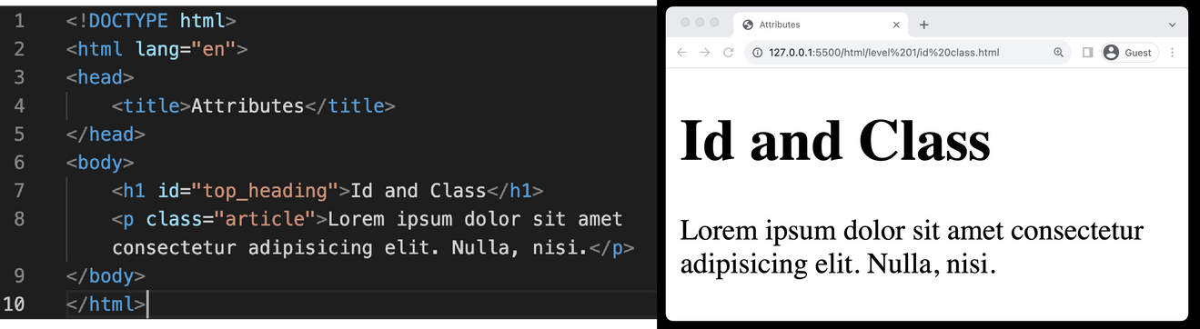
8.
Selectors
(id& classproperty)
• •
•
•
ID Property: Assigns a unique identifier to a single HTML element. Class Property: Allows grouping of multiple HTML elements to style them collectively. Reusable Classes: Class properties can be reused across different
elements for consistent styling.
Specificity and Targeting: Both properties assist in targeting
specific elements or groups of elements for precise styling.

Slide 14
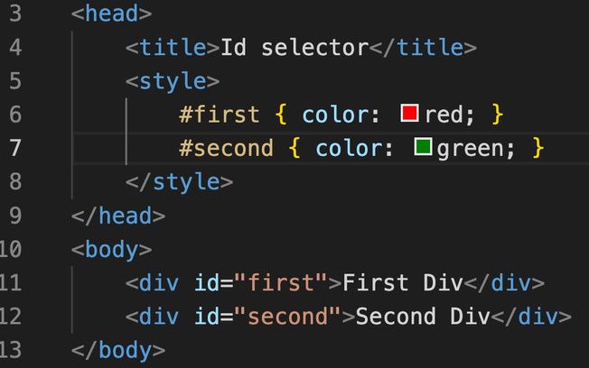
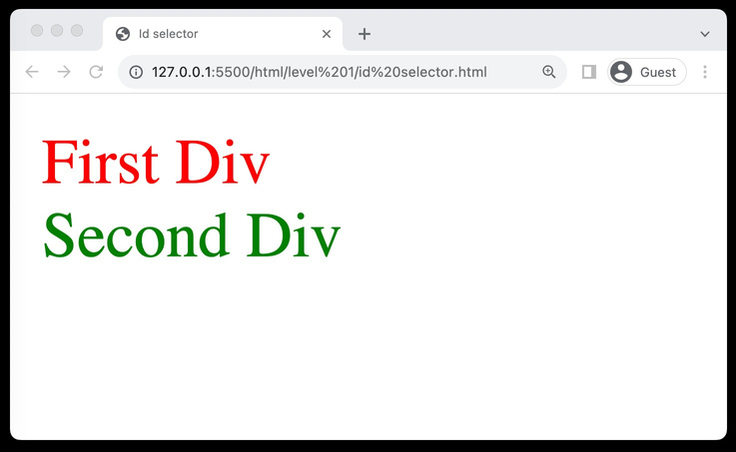
8.
Selectors
(Id selector)
• •
•
•
Unique Identifier: Targets a specific element with a unique ID attribute. Syntax: Uses the hash (#) symbol
Single Use: Each ID should be used once per page for uniqueness.
Specific Targeting: Ideal for styling individual, distinct elements.

Slide 15
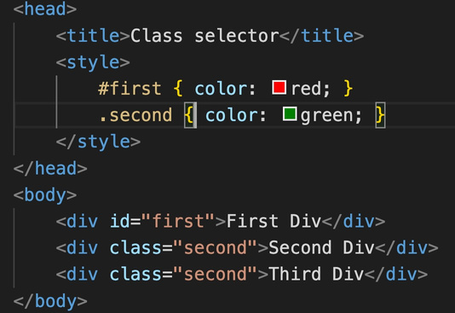
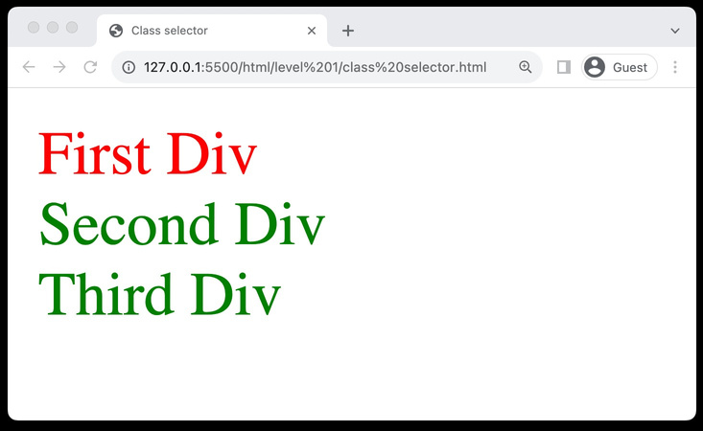
8.
Selectors
(Class selector)
• •
•
•
Group Styling: Allows styling of multiple elementsgrouped under a class. Syntax: Utilizes the dot (.)symbol. Reusable: Can be used on multiple elements for consistent styling. Versatility: Ideal for applying styles to a category of elements.

Slide 16
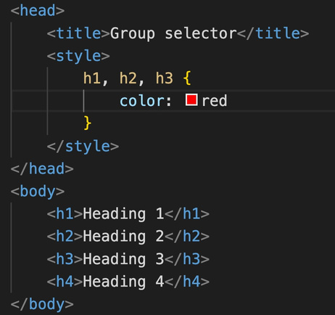
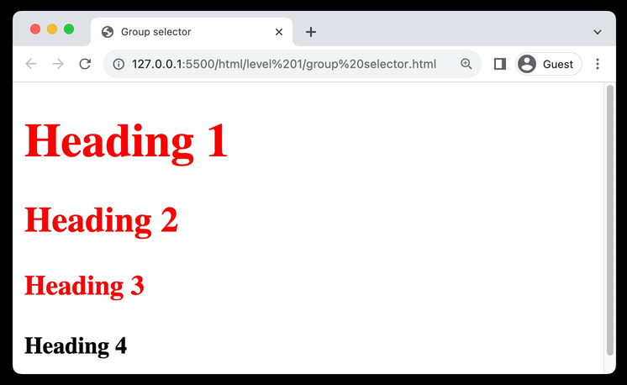
8.
Selectors
(Group selector)
• • •
Multiple Elements: Styles multipleelements simultaneously. Syntax: Separates selectors with commas. Efficiency: Reduces code redundancyand saves time.

Slide 17
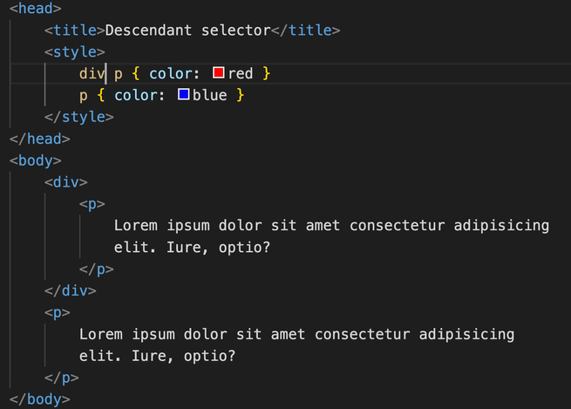
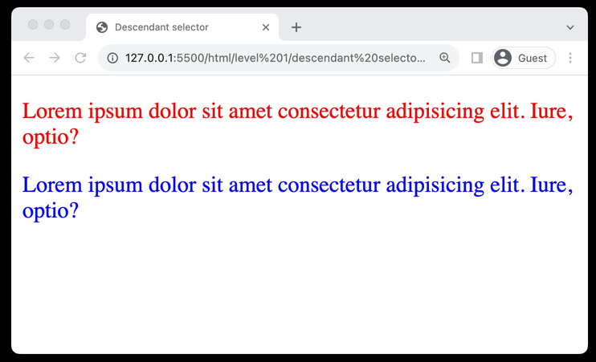
8.
Selectors
(Descendant selector)
• • • •
Nested Targeting: Styles elements nestedwithin a specified element. Syntax: Separate selectors with spaces. Hierarchy-Based: Allows styling based on the hierarchicalstructure of HTML. Specific Styling: Facilitates more targetedand specific styling of elements.

Slide 18
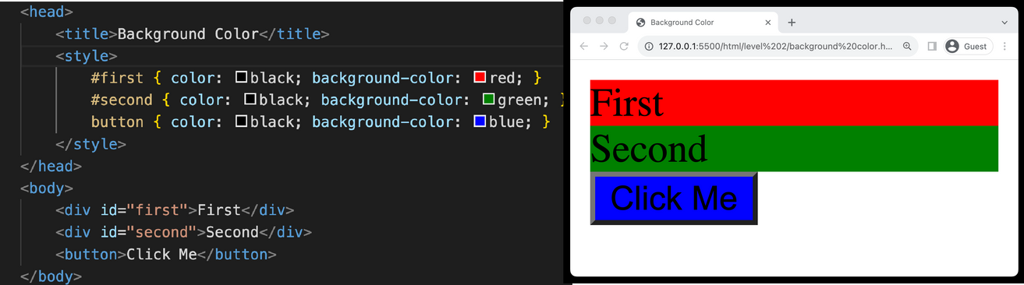
9.
Background Color
• • •
Definition: Sets the background color of an element. Syntax: Utilized as background-color: color; Visual Appeal: Enhances the visual appeal and contrast of webpage elements.

Slide 19
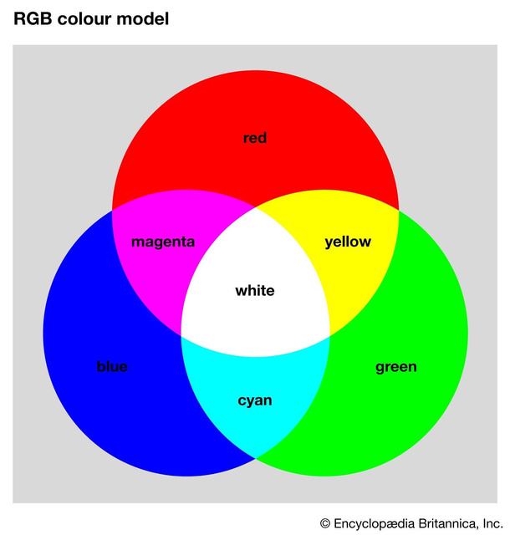
10.
Color System
(Color Theory)
• • • • •
RGB Model: Creates colors by mixing Red (R), Green (G), and Blue (B)light sources. Additive Model: More light means increased brightness. Primary Colors: R, G, and B are the foundational colors. White & Black: All combined yield white; absence equals black. Color Depth: Allows for millions of color variations.

Slide 20
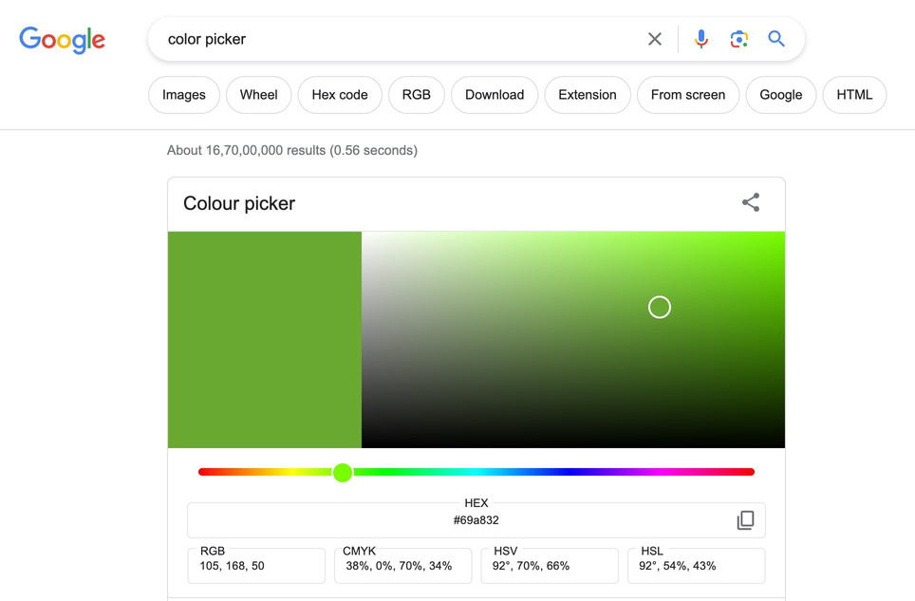
10.
Color System
(color picker)

Slide 21
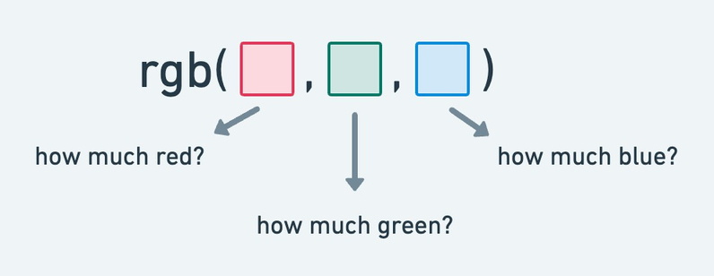
10.
Color System
(RGB Color Model)
• •
Three Channels: Consists ofRed (R), Green (G), and Blue (B) channels to create a variety of colors. Syntax: Utilized as rgb(r, g, b) where r, g, and b are values between 0 and 255.

Slide 22
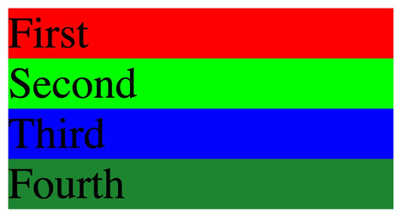
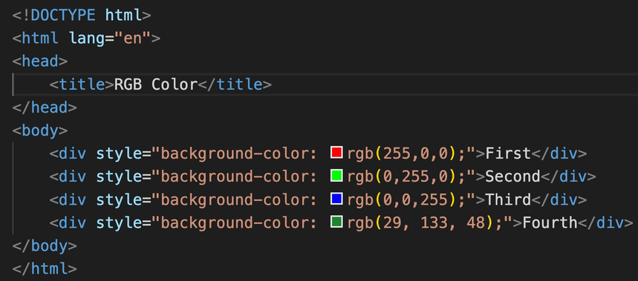
10.
Color System
(RGB Color Model)

Slide 23
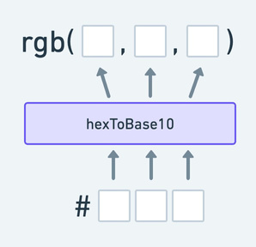
10.
Color System
(HEX Color Model)
•
Hexadecimal Codes: Represents colors using hexadecimal values, consisting of 6 digits combined from numbers and letters (A-F). Syntax: Written as #RRGGBB Easy Color Matching: Facilitates easy color matching with graphic design tools and branding colors. Web Standards: Widely supported and a common standard for defining colors in web design
• •
•

Slide 24
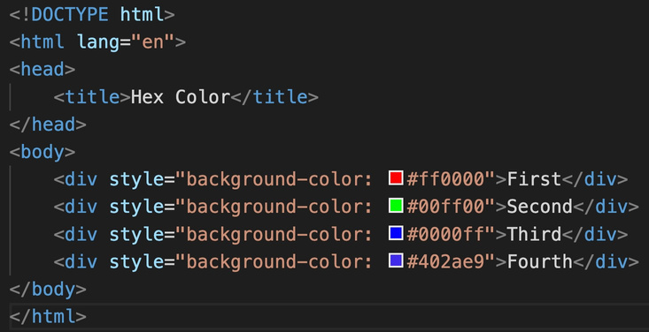
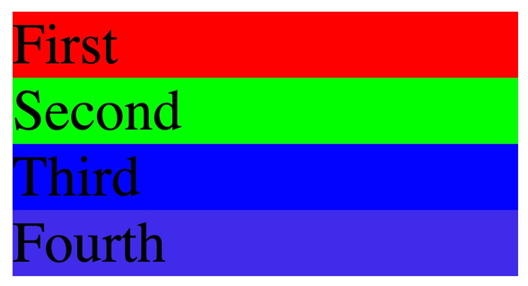
10.
Color System
(HEX Color Model)

Slide 25
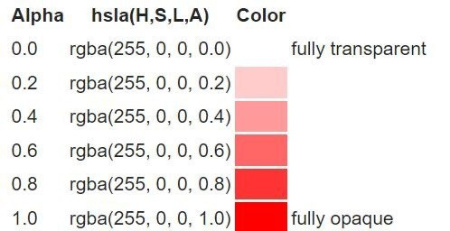
10.
Color System
(Alpha Channel)
• • • •
RGBA: RGB's extension, includes alpha for opacity control (0-1 range). Transparency Control: Facilitates the adjustment of transparency levels in colors. Visual Effects: Enables the creation of visual effects like shadows and overlays. Layering: Assists in layering elements with varying degrees of visibility.

Slide 26
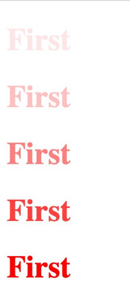
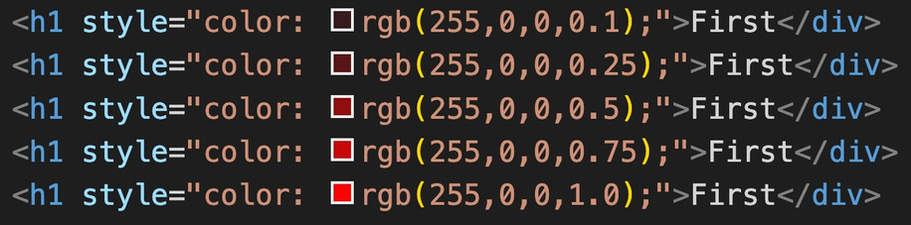
10.
Color System
(Alpha Channel)

Slide 27
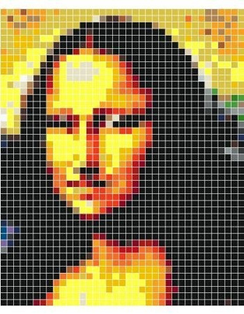
11.
Absolute Units
• • •
Definition: Pixels (px)are fixed-size units, representing a dot on a computer screen. Precision: Allows for precise control over element dimensions. Graphics & Web Design: Commonly used in graphics and web design for setting font sizes, margins, and more. Cross-Browser Consistency: Provides consistency across different browsers. High-DPI Displays: Can vary in appearance on high-DPI (dots per inch) displays.
• •

Slide 28
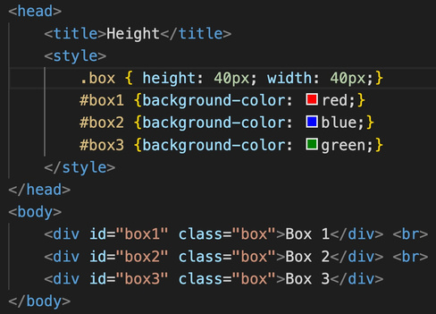
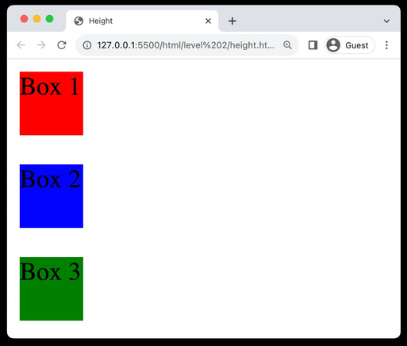
12.
Height & Width Property
• • • •
Dimensions Control: Used to specify the heightand widthof elements. Unit Variability: Can use units like pixels (px) Box Model Component: Influences padding, border, and margin. Min and Max Values: Can utilize min-height, max-height, min-width,
and max-width to set restrictions on dimensions.

Slide 29
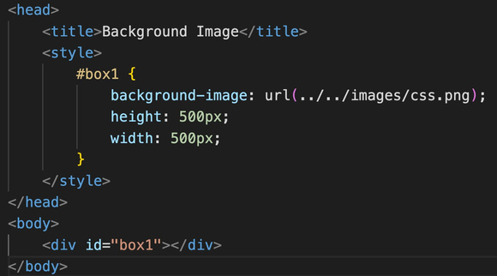
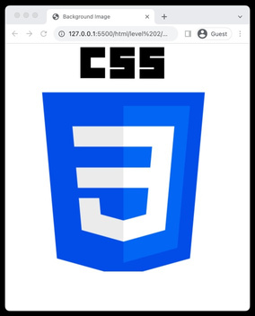
13.
Background image Property
• •
• • • •
Usage: Adds an imageas a background to elements. Syntax: Defined using background-image: url('path/to/image’);.
Repetition: Control image repetition using
background-repeat.
Positioning: Adjust image position using background-
position.
Size Control: Manipulate image size using
background-size. Background-Attachment: Sets whether the background image scrollswith the element or remains fixed. Shorthand(color, image, repeat, attachment,
position)
•

Slide 30
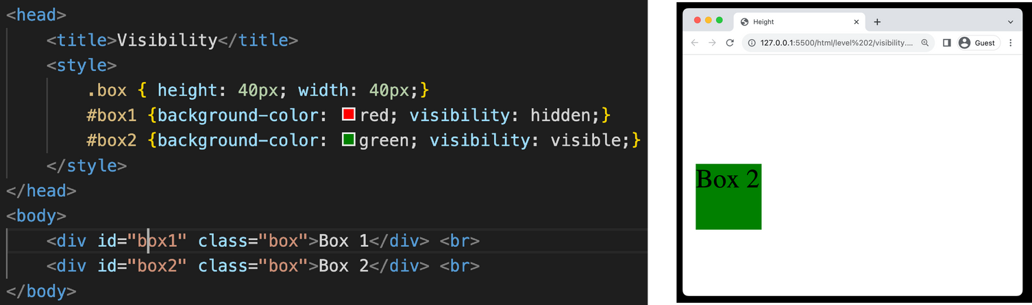
14.
Visibility Property
• • • •
Usage: Controls the visibilityof elements without changing the layout. Values: Can take visible, hidden, or collapse as values. Space Occupancy: Even when hidden, the element occupies space. Interactivity: Hidden elements are not accessible to user interactions.

Slide 31
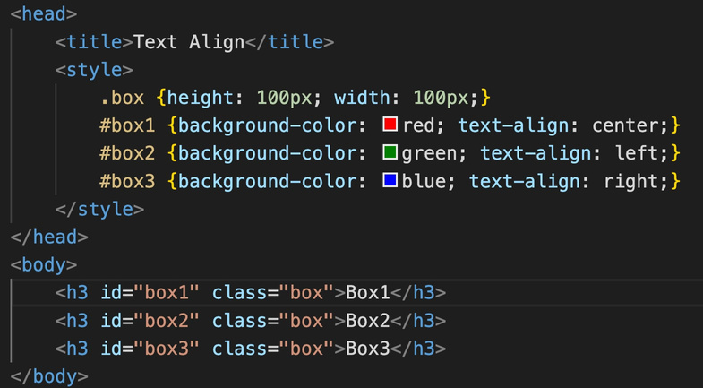
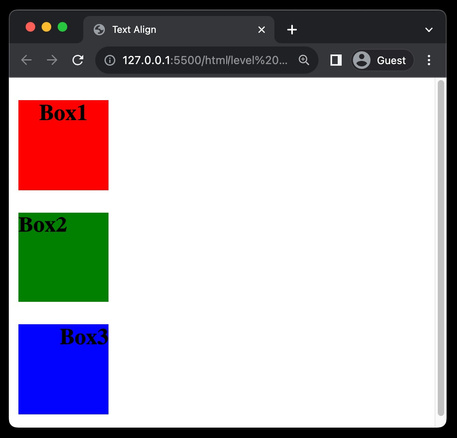
15.Text-Align
Property
• •
•
Usage: Controls the horizontal alignment of text within an element. Values: Can take values like left, right, center, and justify. Visual Appeal: Enhances readability and visual appeal by
organizing text neatly.

Slide 32
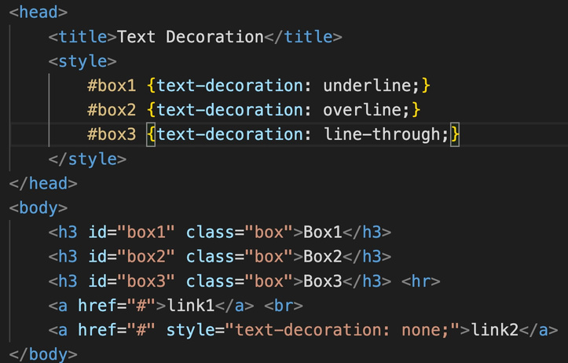
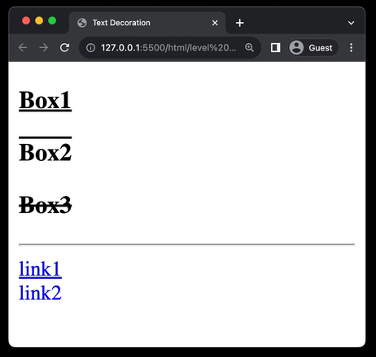
16.Text-Decoration
Property
• • •
Usage: Modifies the appearance of inline text. Values: Options include none, underline, overline, andline-through. Hyperlinks: Commonly used to remove underlines from hyperlinks for aesthetic purposes.

Slide 33
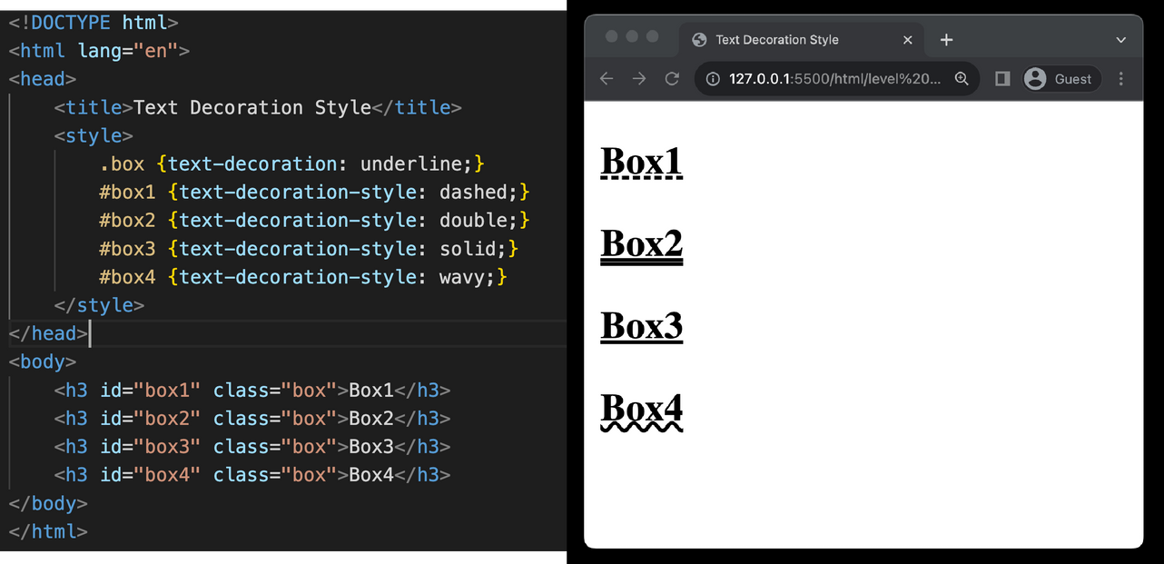
16.Text-Decoration Property
(style)

Slide 34
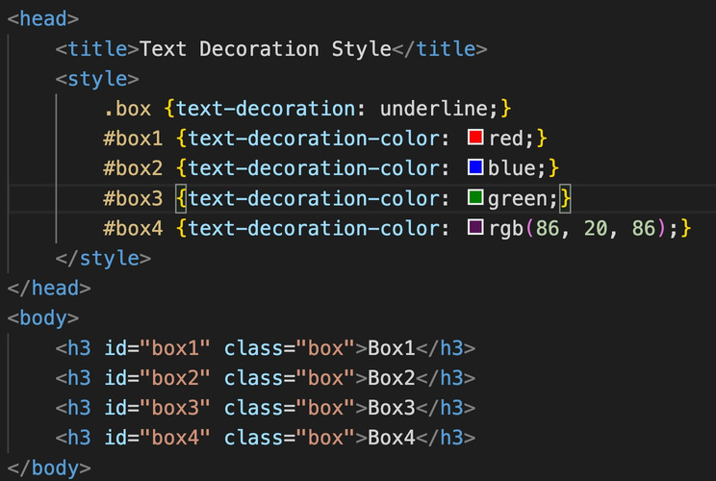

16.Text-Decoration Property
(color)

Slide 35


17.
Text-Transform Property
• • • •
Usage: Controls the capitalizationof text. Common Values: Can be uppercase, lowercase, orcapitalize. None Value: none value disablestext transformations. Typography: Useful for setting text style and improving typographyin web design.

Slide 36

18.
Line Height
• • •
Usage: Adjusts the amount of space above and belowinline elements. Readability: Enhances text readability by preventing overcrowding. Vertical Spacing: Useful for controlling vertical spacing between lines of text.

Slide 37


19.
Font Property
(font-size)
• •
•
Usage: Sets the size of the font in web content. Responsiveness: Helps in creating responsive designs adaptable to various screen sizes. Readability: Crucial for ensuring the readabilityof text on websites.

Slide 38

19.
Font Property
(font-weight)
• • •
Usage: Defines the thicknessof characters in a font. Values: Can take values like normal, bold, bolder, or numeric values (100 to 900). Text Emphasis: Utilized to emphasize text or create contrast between text elements.

Slide 39

19.
Font Property
(font-style)
• • •
Usage: Controls the styleof the font, mainly affecting its inclination. Values: Common values are normal, italic, andoblique. Text Formatting: Useful for highlightingor distinguishing certain text segments.

Slide 40

20.
Font Family
• • •
Usage: Defines which font should be used for text within an element. Specific Fonts: Common choices include Arial, Segoe UI, Times New Roman, and others. Fallback Mechanism: Incorporate a fallback font family in case the primary font is unavailable; helps in maintaining the site
aesthetics.
Web Safe Fonts: Employ web-safe fonts to ensure consistency across different browsers and operating systems. Generic Family: Always end the font family list with a generic family like serif or sans-serif as a last resort option.
•
•

Slide 41

20.
Font Family

Slide 42


21.Iconsusing
Fonts
Using https://fontawesome.com

Slide 43

22.What is Box
Model
•
Core Concept: Central concept in CSS that outlines the design and layout of elements on the web page.
Components: Consists of four main components -margin, border, padding, and content.
Margin: The space outside the border,
separating the element from others.
Border: The outline that encapsulates the padding and content.
Padding: The space between the border and the actual content, providing a buffer.
Content: The innermost layer where text, images, or other media are housed.
•
• • • •

Slide 44


23. Padding
Property
• • •
Usage: Defines the space between the content of an element and its border.
Individual Sides: Allows setting padding for individual sides using padding-top, padding-right, padding-bottom, andpadding-left.
Shorthand: Can use shorthand property padding to set all sides at
once, e.g., padding: 10px 20px 10px 20px.

Slide 45

24. Margin
Property
• • • •
Functionality: Sets the space around elements, separating them from others. Individual Sides: Customizable for top, right, bottom, and left sides. Shorthand: Allows quick setup, e.g., margin: 10px 20px. (clockwise)
Auto Value: Can be used for central alignment with autovalue.

Slide 46



24. Border
Property
• • • •
Usage: Creates an outline around HTMLelements.
Components: Defined by width, style, andcolor attributes.
Styles: Includes options like solid, dashed, anddotted.
Shorthand: Can set attributes at once, e.g., border: 2px solid black.

Slide 47


24. Border
Property
(border radius)
• • •
Usage: Used to create rounded corners for elements.
Individual Corners: Allows setting different radii for each corner. Shorthand:e.g., border-radius: 10px 20px.

Slide 48




24. Border
Property
(box sizing)

Slide 49


26.DisplayProperty
(Block / Inline Elements)
Block Elements
Inline Elements
● ● ● ● ●
New Line:Start on a new line.
Full Width: Take up all horizontal space. Styling:Can have margins and padding. Size: Width and height can be set. Examples: <div>, <p>, <h1>, <ul>, <li>.
● ● ● ● ●
Flow:Stay in line with text.
Width:Just as wide as the content.
No Break:No new line between elements. Limited Styling:Can't set size easily. Examples:<span>, <a>, <strong>, <em>.

Slide 50



26. Display Property
(Block)

Slide 51



26. Display Property
(Inline)

Slide 52



26. Display Property
(Inline-Block)

Slide 53



26. Display Property
(None)

Slide 54

FF5F1F
27. Responsive Website

Slide 55

27. Responsive Website
1.Adapts layout for different screen sizes
2. Flexible layouts
3.Optimizes images and assets
4.Enhances user experience on mobile
and
desktop

Slide 56

28. Relative Units

Slide 57



28.RelativeUnits
(Percentage)
• • •
Relative Sizing: Facilitates dynamic sizing relative to parents. Adaptability: Ensures responsiveness across various screens. Dimensions: Quickly set width and height as a percentage.

Slide 58



28.RelativeUnits
(EM)
• • •
Relative Unit: Sized relative to the parent element's font size. Scalability: Facilitates easy scalingof elements for responsive design. Font Sizing: Commonly used for setting font sizes adaptively.

Slide 59


28.RelativeUnits
(REM)
• • •
Relative Sizing: Facilitates dynamic sizing relative to root element. Adaptability: Ensures responsiveness across various screens. Dimensions: Quickly set width and height as a percentage.

Slide 60


28.RelativeUnits
(VW/VH)
• • •
Viewport Relative Units: Units based on viewport's width (vw) or height (vh) for responsive design.
Responsive Layouts: Essential for creating adaptive layouts; e.g., height: 100vh for full-screen sections.
Element Sizing: Useful for defining heights and widths that scale with the
viewport.

Slide 61

29. Position Property
• •
•
•
Static(default) : Elements follow the normal document flow. (top, right, bottom, left, z-index would not work) Relative: Element's position adjusted from its normal position. Absolute: Positions element relative to the nearest positioned ancestor.
Fixed: Element positioned relative to the viewport, does not move on scroll.

Slide 62



29. Position Property

Slide 63



29.PositionProperty
(z index)
• • •
•
Stacking Order: Determines the stacking order of elements along the Z-axis.
Position Context: Only applies to elements with position set to relative, absolute, fixed, or sticky.
Integer Values: Accepts integer values, including negative numbers.
Higher Values: An element with a higher z-index value appears
above others.

Slide 64


30.
Semantic Tags

Slide 65
30.
Semantic Tags
Semantic Tags
Non-Semantic Tags
● ● ●
Meaningful: Describe content. SEO: Good for search engines. Accessibility: Useful for screen readers.
Examples: <header>, <footer>, <article>, <setion>, <nav>.
●Generic: No specific meaning.
● ●
For Styling: Used for layout. No SEO: Not SEO-friendly.
●Examples: <div>, <span>, <i>,
●
<b>.

Slide 66



31.
Float Property
• • •
Element Alignment: Allows elements to be aligned to the left or right within their containing element.
Values: Can take values like "left", "right", or "none" to determine the floating direction.
Old Layout Technique: Less commonly used with the advent of Flexbox.

Slide 67

32.What is Flexbox?
Flexboxis a one-dimensional layout method for arranging items in rows or columns. Itemsflex(expand) to fill additional space or shrink to fit into smaller spaces.

Slide 68

33.
Flex Model
display: flex

Slide 69

34.
Flexbox Direction
• • • •
Property Name: flex-direction is the property used to define the direction in a flex container.
Row Layout: rowvalue aligns the flex items horizontally, in a left-to-right fashion.
Column Layout: columnvalue stacks the flex items vertically, from top to bottom.
Reverse Direction: Adding -reverseto row or column (as in row-reverseor column-reverse) reverses
the order of the items.

Slide 70



34.
Flexbox Direction

Slide 71


34.
Flexbox Direction

Slide 72

35.
Properties: Flexbox container
(Justify Content)
• • • • •
Alignment: Aligns flex items along the main axis. flex-start: Items align to the start of the flex container. flex-end: Items align to the end of the flex container. Center: Items are cantered within the flex container. space-between/space-around/space-evenly:
Distributes space between items evenly.

Slide 73


35.
Properties: Flexbox container
(Justify Content)

Slide 74

35.
Properties: Flexbox container
(Flex Wrap)

Slide 75


35.
Properties: Flexbox container
(Flex Wrap)

Slide 76


35.
Properties: Flexbox container
(Align Items)
This property is used to align the flex container's items along the cross-axis, which is perpendicular to the main axis.

Slide 77


35.
Properties: Flexbox container
(Align Content)
It is utilized to adjust the spacing between flex lines within a flex container, particularly when there is extra space along the cross- axis.

Slide 78


36.
Properties: Flex Items
(Align Self)
Allows individual flex items to override the container's align-itemsproperty, aligning them differently along the cross-axis.

Slide 79


36.
Properties: Flex Items
(Flex Shrink)
The "flex-shrink" property in CSS determines how much a flex item will shrink relative to other items in the flex container if there is insufficient space.

Slide 80


36.
Properties: Flex Items
(Flex Grow)
The "flex-grow" property in CSS specifies how much a flex item will grow relative to other items in the flex container when additional space is available.

Slide 81


36.
Properties: Flex Items
(Order)
The "order" property in CSS allows you to define the sequence in which flex items appear within the flex container, overriding their original order in the HTML.

Slide 82

37.
Grid

Slide 83



37.
Grid
• • • • •
2D layout system for rows & columns. Activate with display: grid;. Children become grid items. Define structure with grid-template properties. Individual units called grid cells.

Slide 84

38.
Media Queries
• •
•
•
•
Tailor styles for specific device characteristics. Use to create responsiveweb designs. Apply styles based on conditions like screen size. Syntax: @media (condition) { CSS rules
}.
Can combinemultiple conditions using
and, or.

Slide 85


38.
MediaQueries
(width)

Slide 86

38.
MediaQueries
(min-width)

Slide 87


38.
MediaQueries
(max-width)

Slide 88

38.
MediaQueries
(combination)

Slide 89


39.
Pseudo Classes
• • • •
Used to define special states of HTML elements. Syntax: selector:pseudo-class{ styles }. Common examples: :hover, :active, :first-child. Target elements based on their position or user
action.

Slide 90

40.
Transitions
CSS transition is a property that enables smooth animation between changesin CSS property values
• • • •
transition-property: Defines which CSS properties will transition. transition-duration: Sets how long the transition lasts. transition-timing-function: Controls the speed curve of the transition. transition-delay: Specifies a delay before the transition starts.

Slide 91


40.
Transitions

Slide 92

41.
CSS Transform
• • • • •
Allows modification of an element's shape and position. Can perform operations like rotate, scale, and translate. Does not affect the layout of surrounding elements.
Used to create visual effects like 3Dspace
transformations.
Implemented with functions like rotate(), scale(), and translate().

Slide 93

41.
CSSTransform
(Rotate)
• •
Rotates an element around a fixed point. Defined using the rotate() function within the transform property. Default rotation point is the
element's center.
•

Slide 94


41.
CSSTransform
(Scale)

Slide 95

41.
CSSTransform
(Translate)

Slide 96


41.
CSSTransform
(Skew)

Slide 97

42.
Animation

Slide 98
42.
Animation Properties
• • • • • •
animation-name:Specifies the name of the @keyframes defined animation. animation-duration: Defines the total time the animation takes to complete one cycle. animation-timing-function: Controls the pacing of the animation (e.g., linear, ease-in). animation-delay: Sets a delay before the animation starts, allowing for a pause bfore initiation. animation-iteration-count: Indicates the number of times the animation should repeat. animation-direction: Specifies the direction of the animation, allowing for reverse or alternate cycles.

Slide 99


42.
Animation

Slide 100


42.
Animation

Slide 101

Project
MyntraClone

